Slide 1


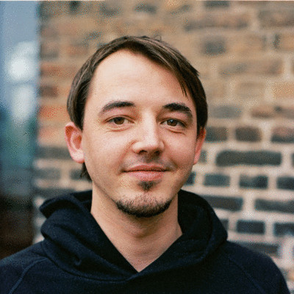
The fabulous G4
Fabian Hieber
Mónia Gomes
Moritz Neujeffski

Slide 2
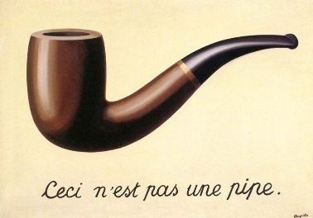
The MFM-24 - a new gold standard in image recognition
Convincing CNNs that yes, this is a pipe ! – Using the CIFAR-10 dataset!
Convincing CNNs that yes, this is a pipe !
Notes:
In this project we developed a Convolutional Neural Network (CNN) model to classify images from the CIFAR-10 dataset. Our custom model consists of 23 layers, including convolutional layers with 64, 128, and 256 filters, BatchNormalization, MaxPooling, Dropout, and GlobalAveragePooling. We compared the performance of our model with the VGG16 architecture and applied transfer learning to improve our model's accuracy. The model was designed for image classification across 10 categories and trained using the CIFAR-10 dataset, achieving competitive results through experimentation and refinement.

Slide 3
Data Preprocessing
CIFAR-10 dataset consists of 32x32 pixel images:
Class labels converted to categorical/One Hot Encoding
Normalized by scaling (0-1)
Augmentation( rotated, flip horizontally, height and width shift)
Resizing imagens 75x75 (InceptionV3 only)
Notes:
For data preprocessing, only minimal steps were required, as the CIFAR-10 dataset consists of 32x32 pixel images, eliminating the need for resizing. The class labels were converted into categorical values to facilitate multi-class classification. Furthermore, we normalized the image data by scaling the pixel values to a range between 0 and 1, which is essential for improving the model's performance. This was done by converting the pixel values to float32 and dividing them by 255.0 for both the training and test datasets. In addition, we undertook data augmentation steps along the way when training our model. Based on these data preprocessing steps we advanced to developing our training model.

Slide 4
CNN Architecture (1/2)
Model# | Key Changes | Optimizer | Key Improvements | Implications
Created during model improvement
1 | Baseline CNN, 1 Conv Layer | SGD | Simple architecture. overfitting | Struggles to capture complexity, needs more layers and regularization
2 | Added BatchNormalization & Dropout (0.25) | SGD | Stabilized training, reduced overfitting | Regularization helped generalization but still lacked complexity
3 | Deepened CNN, more Conv Layers (64/128) | SGD | Better feature extraction due to increased depth | Higher accuracy but higher computational cost
4 | GlobalAveragePooling instead of Flatten | SGD | Reduced model size, same performance | Efficient without sacrificing accuracy
5 | Switched to Adam Optimizer | Adam | Faster convergence, improved performance | Adam’s adaptive learning rates led to quicker training

Slide 5
CNN Architecture (1/2)
Model# | Key Changes | Optimizer | Key Improvements | Implications
Created during model improvement
6 | Introduced EarlyStopping | Adam | Reduced overfitting, halted unneeded training | Generalization improved; training time reduced by 15-20%
7 | Added more filters (256) | Adam | Increased depth, better accuracy | Higher computational cost, diminishing returns in accuracy improvement
8 | Reduced Batch Size to 128 | Adam | More precise weight updates | Slight improvement but longer training time
9 | Added Data Augmentation | Adam | Reduced overfitting, better generalization | Augmentation improved model robustness

Slide 6
CNN Architecture (2/2)
Model# | Key Changes | Optimizer | Key Improvements | Implications
Created during model improvement
10 | Reduced learning rate to 0.001, Data Aug. | Adam | Finer updates, improved stability | Combination of low learning rate and augmentation helped stability
11 | VGG-replica deep network with Dropout | Adam | High accuracy but computationally expensive | VGG architecture offers good depth, but resource-intensive
Notes:
CNN Architecture:
Present the CNN architecture you designed, using diagrams to illustrate (1-2 slides).

Slide 7
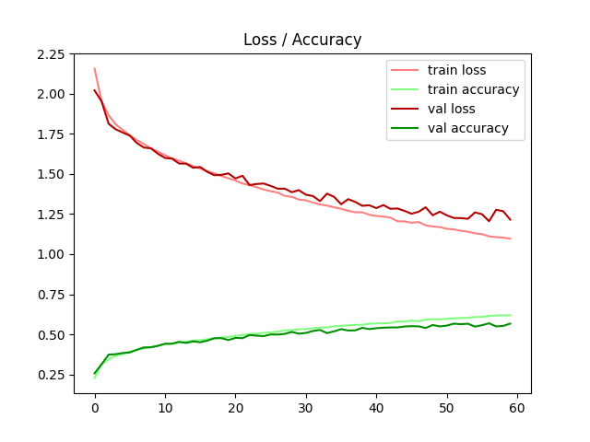
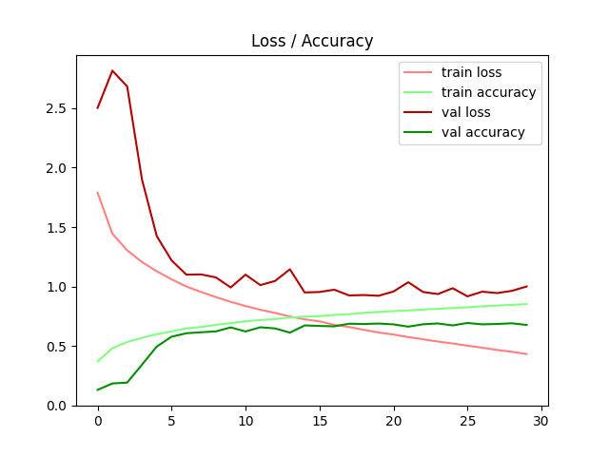
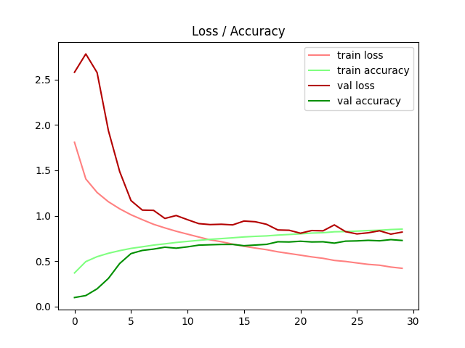
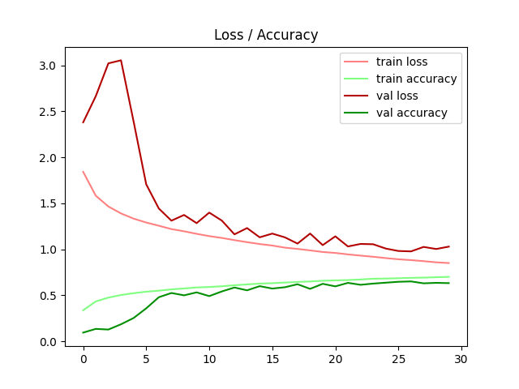
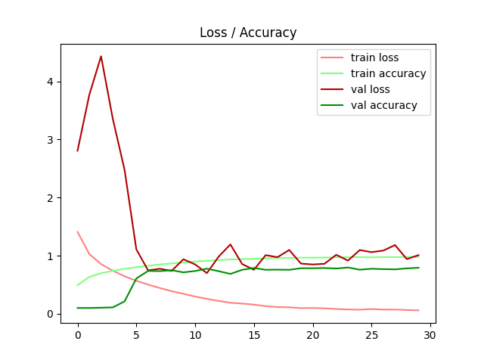
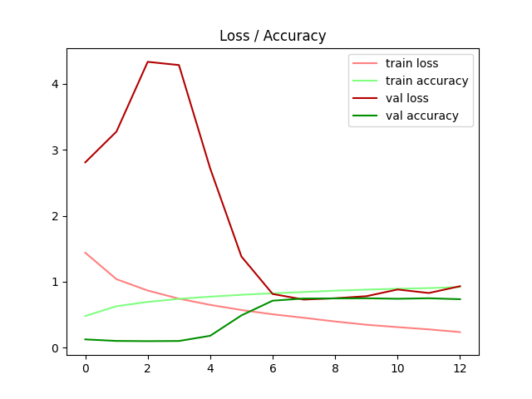
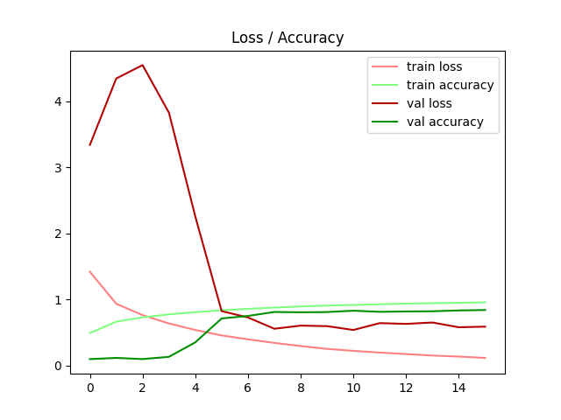
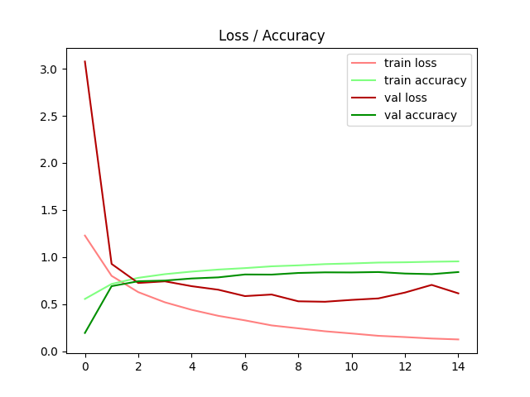
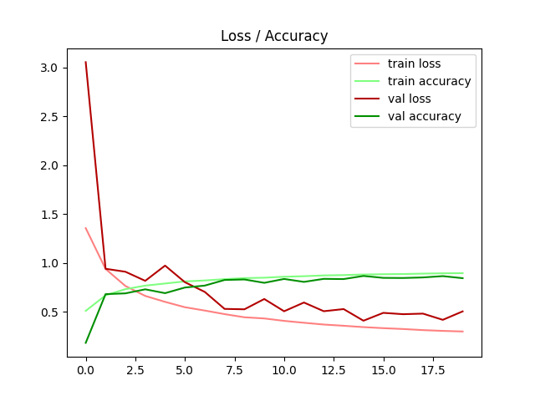
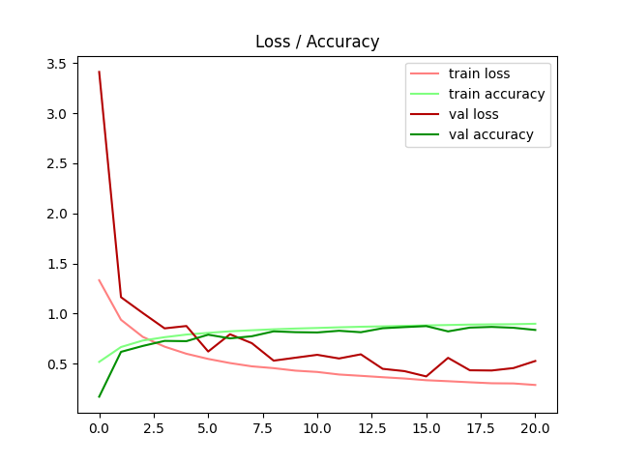
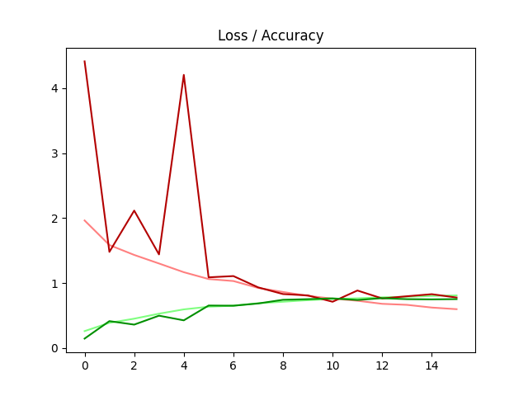
G4 Never Ending Story –CNN Models Eval : Model 10 Wins!!!
Model 1 | Model 2 | Model 3 | Model 4 | Model 5 | Model 6
Model 7 | Model 8 | Model 9 | Model 10 | Model 11
Notes:
The initial model’s architecture consisted of one convolutional layer (32 filters, ReLU activation), followed by a flattening layer and two dense layers (100 neurons and 10 neurons, respectively). The final layer used softmax for multi-class classification. We used a Stochastic Gradient Descent (SGD) with categorical cross-entropy loss and trained the model for 60 epochs. As shown in Table 1 below, we initially achieved an accuracy rate of 0.62. Gradually we improved the performance by taking various steps such as Adding BatchNormalization and Dropouts (model 2); deepening the network by adding 4 Convolutional Layers (model 3) or replacing the flatten function in the end with GlobalAveragePooling2D (model 4). The GlobalAveragePooling helped by increasing the efficiency without sacrificing accuracy.
Further steps included switching the model optimizer to Adam (model 5); introducing EarlyStopping (model 6), adding two convolutional blocks with 256 filters (model 7) and reducing the batch size from 512 to 128 (model 8). Especially Adam’s adaptive learning rates led to quicker training and improved the accuracy significantly. This also held true for adding more layers and working with a smaller batch size, which resulted in more frequent updates to the model weights during training and improved our performance again (see table 1). As our validation loss was still much higher than our loss, we introduced data augmentation techniques to reduce the overfitting of our model (model 9). Specifically, we applied random horizontal shifts and rotations to the input images. This decreased the validation loss to under 50%.
In the last step, now in model 10, we decreased Adam’s learning rate to 0.001. This lowered the learning rates and led to finer updates, decreasing overfitting. This resulted in an accuracy rate of 0.91, a loss of 0.26, a validation accuracy of 0.87 and a validation loss of 0.42. Thus, model 10 – the MFM-24 – provided the best results. The MFM-24 starts with two convolutional layers with 64 filters to capture low-level features, followed by BatchNormalization and MaxPooling to normalize activations and reduce spatial dimensions, respectively. As the network deepens, we use higher filter counts (128 and 256) in subsequent layers to capture more complex patterns, applying Dropout to prevent overfitting. The model concludes with a GlobalAveragePooling layer and two dense layers, allowing it to flatten the feature maps and classify images into 10 categories.
Further attempts to, for example, reduce the learning rate only resulted in minor effects on improving the model’s performance, the gains became marginal at this stage. Lastly, we reduced the dropout rate, but additional reductions in this hyperparameter also yielded diminishing returns (see model 11 in table 1). We concluded our optimization efforts when the model's performance plateaued, as additional changes no longer led to meaningful improvements.

Slide 8
Transfer Learning
Model# | Key Changes | Optimizer | Key Improvements | Implications
Used in transfer learning
12 | VGG16 pre-trained (frozen layers) | Adam | Transfer learning improved accuracy | Efficient training due to pre-trained layers
13 | Fine-tuned VGG16 | Adam | Fine-tuning boosted performance | Fine-tuning enabled better adaptation to CIFAR-10 dataset
14 | ResNet50 (transfer learning, frozen layers) | Adam | Strong feature extraction via ResNet | Skip connections helped deeper training, great performance
15 | InceptionV3 (input resized to 75x75) | Adam | Mixed convolutions, strong generalization | InceptionV3 balances complexity and accuracy
16 | Fine-tuned VGG16, lower learning rate | Adam | Best performance due to fine-tuning | Fine-tuning with a low learning rate resulted in high accuracy
Notes:
To test our model, we chose three pre-trained models to do transfer learning. These were VGG16, ResNet50 and InceptionV3.
InceptionV3 uses multiple convolutional filter sizes in parallel within the same layer, allowing the model to capture both fine and coarse features, which makes it highly efficient in terms of computational complexity while maintaining high accuracy.
ResNet-50 introduces residual learning by using skip connections to bypass certain layers, enabling the training of much deeper networks by mitigating the vanishing gradient problem.
VGG16, a deep convolutional network with 16 layers that uses very small 3x3 filters, designed to emphasize depth and simplicity, offering strong performance in image classification at the cost of high computational requirements.
Initially we attempted to run the three pre-trained models on our training dataset with the least modifications possible. At this stage we only undertook modifications to fit the pre-trained models to our pre-processed training datasets. This included the data augmentation process of randomly rotating and flipping images horizontally. As the table below (Table 2) shows, VGG16 revealed the best performance on the CIFAR-10 dataset.

Slide 9
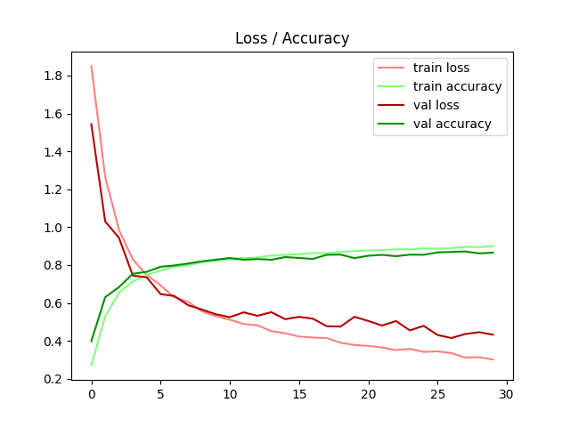
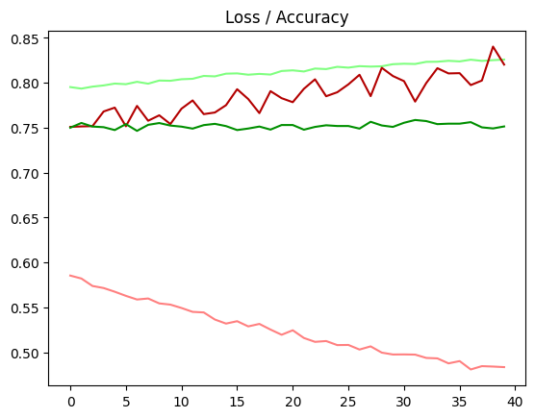
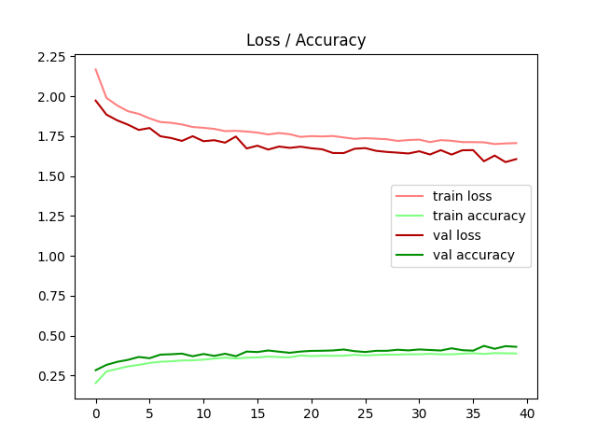
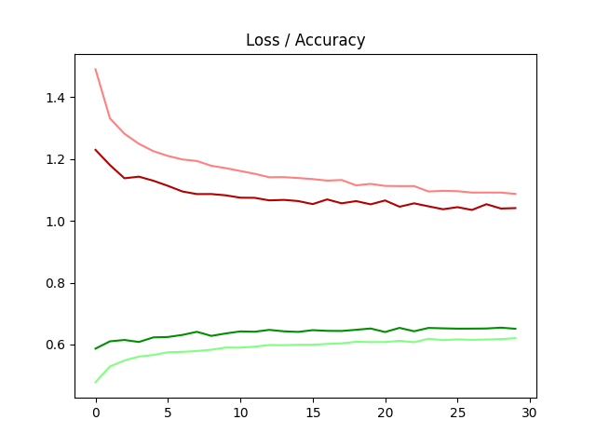
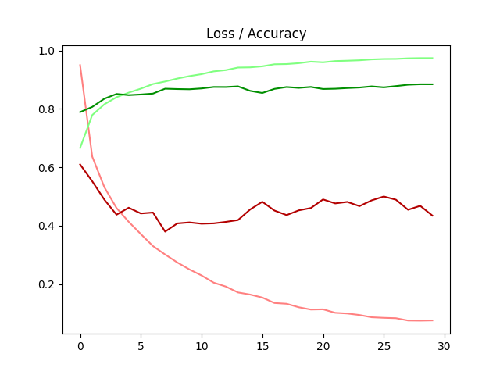
G4 Transfer Learning EVAL : VGG16 Wins!!!
Model 12 | Model 13 | Model 14 | Model 15 | Model 16
Notes:
Model 1: Basic CNN ArchitectureKey Takeaway: This model demonstrates slow improvement in accuracy, with both training and validation curves rising gradually. The training loss decreases steadily, but validation loss diverges from training loss after ~20 epochs, suggesting overfitting. The model has limited complexity, leading to underfitting on the training data.
Model 2: CNN with Batch Normalization and DropoutKey Takeaway: Model 2 shows a more dramatic reduction in training loss early on, with a faster accuracy rise. However, validation loss is still slightly higher than training loss, indicating slight overfitting. The introduction of Batch Normalization helped improve convergence, and Dropout assisted in reducing overfitting.
Model 3: Deeper CNN with Additional FiltersKey Takeaway: The accuracy improves more rapidly in this model, and the validation loss stabilizes better than in Model 2. The deeper architecture with added convolutional layers allowed the model to learn more complex features, leading to a higher overall performance.
Model 4: Global Average Pooling AddedKey Takeaway: Using GlobalAveragePooling2D reduced the number of parameters, which improved training stability. The training and validation accuracy are close, showing less overfitting, but the accuracy increase slows down after ~15 epochs, indicating room for improvement in model capacity.
Model 5: Use of Adam OptimizerKey Takeaway: The Adam optimizer accelerates training, leading to a quicker convergence of both accuracy and loss. The sharp decline in validation loss after 5 epochs indicates better learning stability compared to SGD, and the validation accuracy curve closely follows the training curve, suggesting better generalization.
Model 6: Early StoppingKey Takeaway: Early stopping prevented overfitting, evident by the close alignment of training and validation loss/accuracy. The model stopped training at an optimal point, allowing it to generalize better without excessive training epochs. The smooth validation accuracy curve shows stable performance.
Model 7: Increased Filter DepthKey Takeaway: By adding more filters, the model achieved even higher accuracy. The sharp decline in both training and validation loss at the beginning shows rapid learning, but the gradual divergence between training and validation accuracy suggests a risk of overfitting with such a deep model.
Model 8: Reduced Batch SizeKey Takeaway: Reducing the batch size to 128 enabled finer updates to the model weights, which improved accuracy. However, training became more unstable with fluctuations in accuracy. This shows the trade-off between batch size and model performance.
Model 9: Data AugmentationKey Takeaway: Data augmentation led to significant improvements in generalization, as seen by the close alignment of training and validation accuracy. The training loss is higher than in previous models due to the augmented and more varied input, which prevents the model from overfitting.
Model 10: Lower Learning Rate with Adam OptimizerKey Takeaway: Reducing the learning rate in combination with the Adam optimizer resulted in smoother and more stable training, allowing the model to converge better. Both training and validation curves are close, indicating strong generalization.

Slide 10
Project Overview / Recap
LESSON LEARNED learned the importance of starting with broad changes, such as modifying batch size, optimizers, layers, and data augmentation techniques:
The MODEL CREATION
Minimalistic data preprocessing and systematic architecture adjustments
BatchNormalization and Dropout - stabilize training and reduce overfitting
Adam optimizer with an adjusted learning rate - accelerated convergence and enhanced accuracy
THE TRANSFER LEARNING
Unfreezing the last four layers of VGG16 - enabled improving accuracy while preserving the pre-trained model’s generalization power
Notes:
From our experience working on CNN model development, we’ve learned the importance of starting with broad changes, such as modifying batch size, optimizers, layers, and data augmentation techniques. This initial experimentation gave us a solid foundation before moving into more precise adjustments. In conclusion, our work on the CIFAR-10 dataset highlights three key strategies that significantly improved model performance. First, leveraging BatchNormalization and Dropout helped stabilize training and reduce overfitting. Second, switching to Adam optimizer with an adjusted learning rate accelerated convergence and enhanced accuracy. Finally, in transfer learning, unfreezing the last four layers of VGG16 enabled improving accuracy while preserving the pre-trained model’s generalization power. These steps, along with minimalistic data preprocessing and systematic architecture adjustments, led to a highly accurate model, achieving 0.97 accuracy, while still facing some overfitting challenges.

